Slide 1
Project Happiness
What makes the world happy?
Data Analysis of Happiness Scores
Presented by Lisa Cannon, Monica Ramos, Xuancong Tran

Slide 2
Motivation and Summary
Levels of happiness vary throughout the world. There are likely many factors that influence the level of happiness in a country. We seek to determine some factors that could be used to predict happiness.
This study seeks to determine:
How happiness is distributed around the world?
What are some of the factors that influence happiness?
While we are able to determine several factors that are predictive of happiness, there are many other factors that are not considered and are beyond the scope of this study.

Slide 3
Questions
Happiness Distribution
How has happiness changed over time?
How is happiness distributed around the world?
Does happiness vary by continent?
Are nearby countries similar in happiness levels?

Slide 4
Questions
Do any of the following factors influence happiness?
GDP/PPP
Population Total/Population Density
Median Age
Alcohol Consumption
Level of Education
Internet Access
Disaster Risk
Amount of Sleep

Slide 5
Data Sources
Happiness data is obtained from The World Happiness Report
The report contains happiness scores and ranking data from the Gallup World Poll.
The poll asks respondents to think of a ladder with the best possible life for them being a 10 and the worst possible life being a 0 and to rate their own current lives on that scale.
Data is available at the country level
The World Happiness Report has rankings and scores for 2015-2018.
Contains data for 157 countries (there are 195 total)

Slide 6
Data Sources
Other sources of data are:
The World Health Organization
World Bank
World by Map
Human Development Reports, United Nations Development Programme
Wikipedia
Statista
Maps are from Google Maps

Slide 7
Data Cleaning
In order to compare happiness scores to information on other factors from the same year, we focused most of our analysis on happiness scores in 2016.
Our interest is only in merging to the countries present in the World Happiness Report.
Because data is pulled from multiple sources, it is important to ensure that the country name is consistent when merging.
Each data source was missing information on a few countries. For this reason, individual variable analyses varies in number of countries included. (Ranging from to 125-155 countries)
Note: The source of sleeping includes information for only about 30 countries.

Slide 8
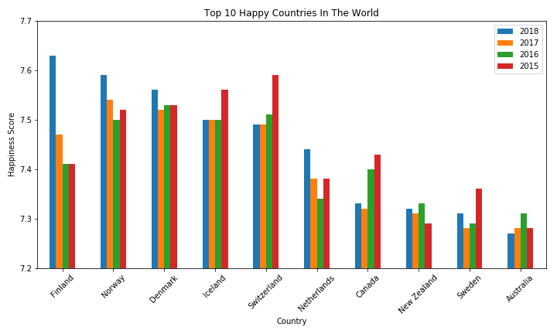
Happiness Score Over Time
The 5 happiest countries tend to stay happy over time. Finland saw a large increase in happiness in 2018.

Slide 9
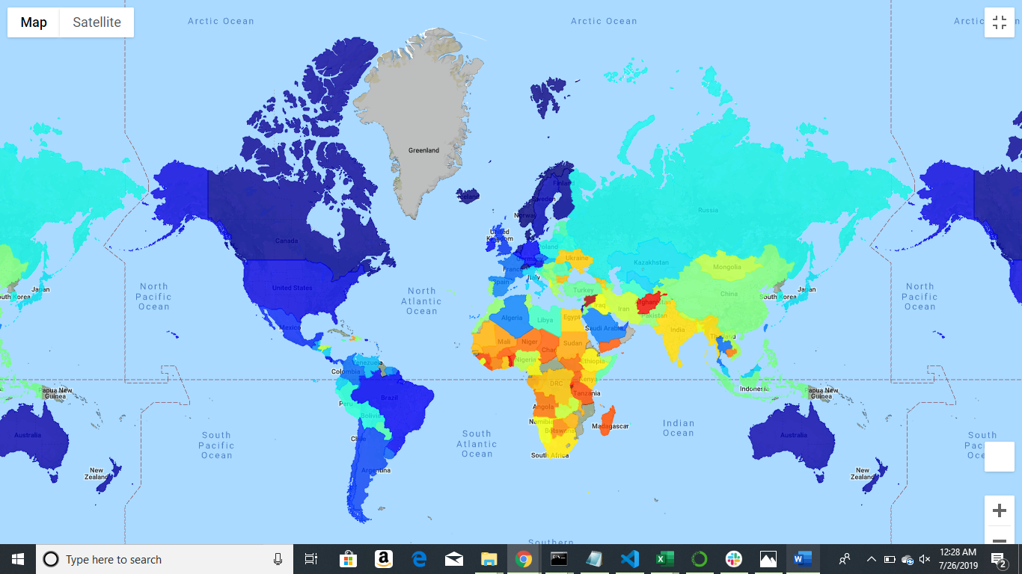
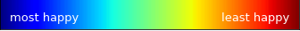
Happiness Score by Country

Slide 10
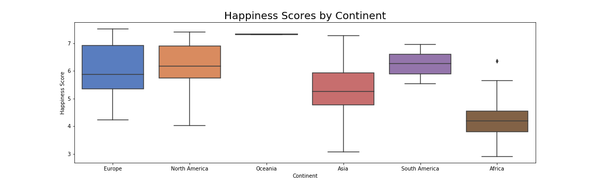
Happiness Distribution by Continent
The distribution of Europe and North America appear to be similar.
The mean of South America is close to Europe and North America
The distribution of Africa’s happiness score is much lower than other continents.

Slide 11
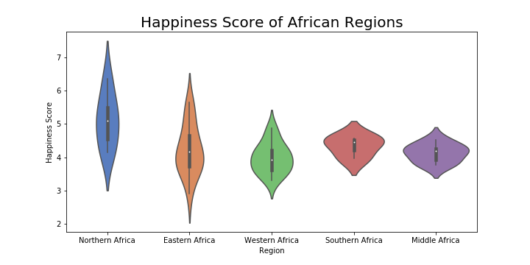
Happy Score for Regions in Africa
The mean of most regions within Africa are similar, but the mean happiness in North Africa is greater.

Slide 12
T-test Comparison of Continents
Continent1 | Continent2 | T-stat | P-Value
Asia | Africa | 5.91587 | 0.00000
Asia | Europe | -4.03539 | 0.00012
Asia | North America | -3.14721 | 0.00453
Asia | South America | -5.14424 | 0.00001
Asia | Oceania | -15.41227 | 0.00000
Africa | Europe | -9.89033 | 0.00000
Africa | North America | -7.06010 | 0.00000
Africa | South America | -11.50633 | 0.00000
Africa | Oceania | -29.02330 | 0.00000
Europe | North America | -0.23084 | 0.81930
Europe | South America | -0.84738 | 0.40247
Europe | Oceania | -8.28201 | 0.00000
North America | South America | -0.37821 | 0.70903
North America | Oceania | -4.82574 | 0.00027
South America | Oceania | -7.82979 | 0.00001

Slide 13
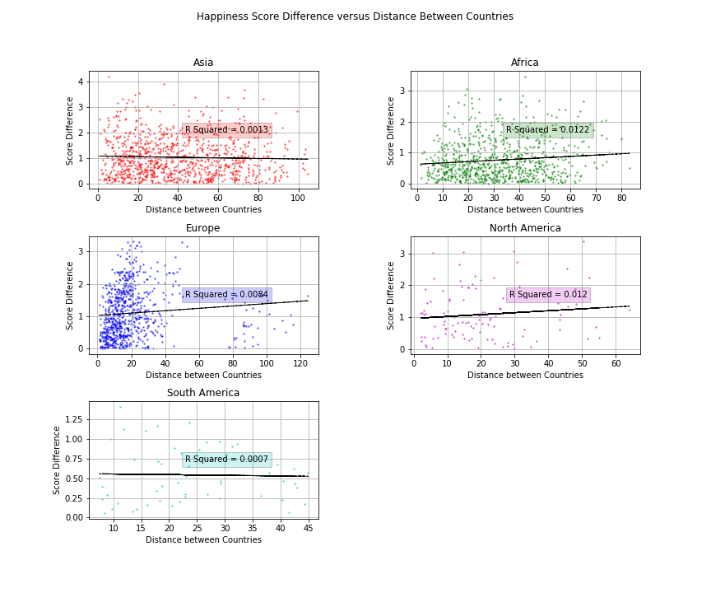
Distance Analysis
There is almost no correlation between distance between countries and difference between scores.
The R Squared values for all continents are very small
The different sizes of countries makes this comparison inconsistent.

Slide 14
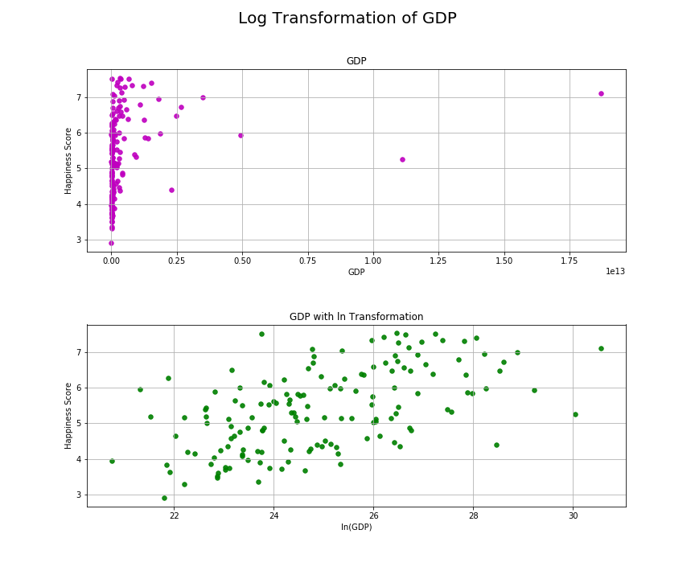
Variable Analysis Is there a relationship between Happiness and Economic Variables?
In order to find a linear relationship, the values of GDP, PPP, Population Density, and Population Total required a log transformation

Slide 15
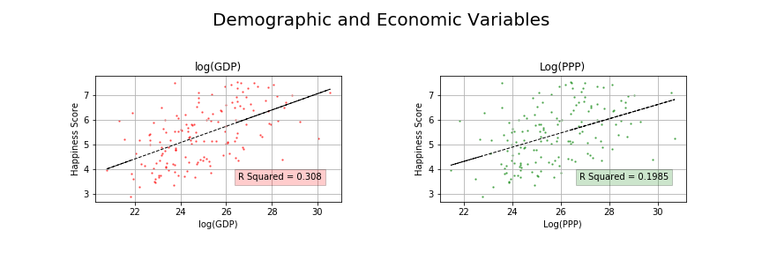
Variable Analysis Is there a relationship between Happiness and GDP/PPP?
Log(GDP) has some relationship with the happiness score.
R squared is 0.308
Wealthier countries tend to be happier.

Slide 16
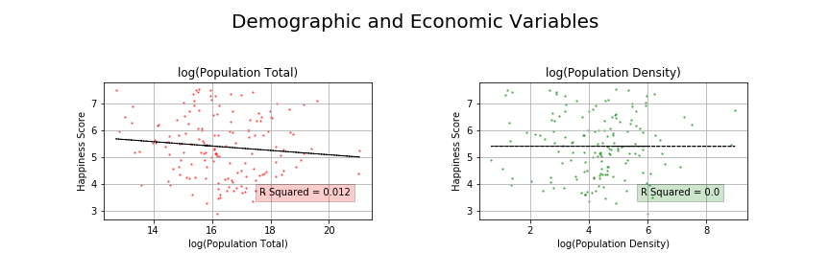
Variable Analysis Is there a relationship between Happiness and Population?
There is no relationship between population and the happiness score.
Country size and population concentration do not affect happiness.

Slide 17
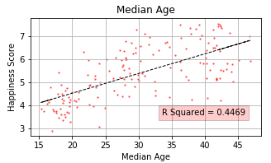
Variable Analysis Is there a relationship between Happiness and Median Age?
There is some relationship between the median age in a country and its happiness score.
A higher median age indicates that people live longer and are likely healthier.
This indicates good health and a long life increase happiness.

Slide 18
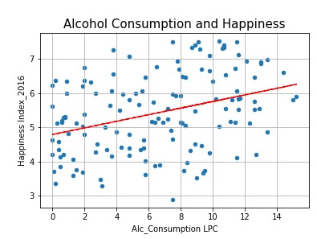
Variable Analysis Is there a relationship between Happiness and Alcohol Consumption ?
Surprisingly, alcohol consumption has a positive correlation with the happiness score. Alcohol consumption has always been linked to be used to cope with pain and despair. It is also linked to crime, violence, accidents and death.
However, in this graph we can see that residents of happy countries probably consume alcohol for reasons like pleasure, indulgence and celebration.
r value: 0.3518

Slide 19
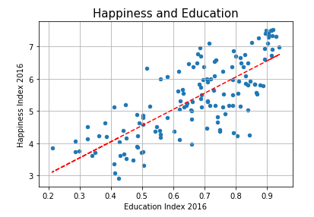
Variable Analysis Is there a relationship between Happiness and Education Index?
This analysis shows that happier nations have a higher Education index than unhappy ones with a strong correlation of 0.76.
We can assume that education is linked to a sense of individual empowerment, community contribution and better job conditions.
All of which contributes to country’s sense of security and well being.
r value: 0.7603

Slide 20
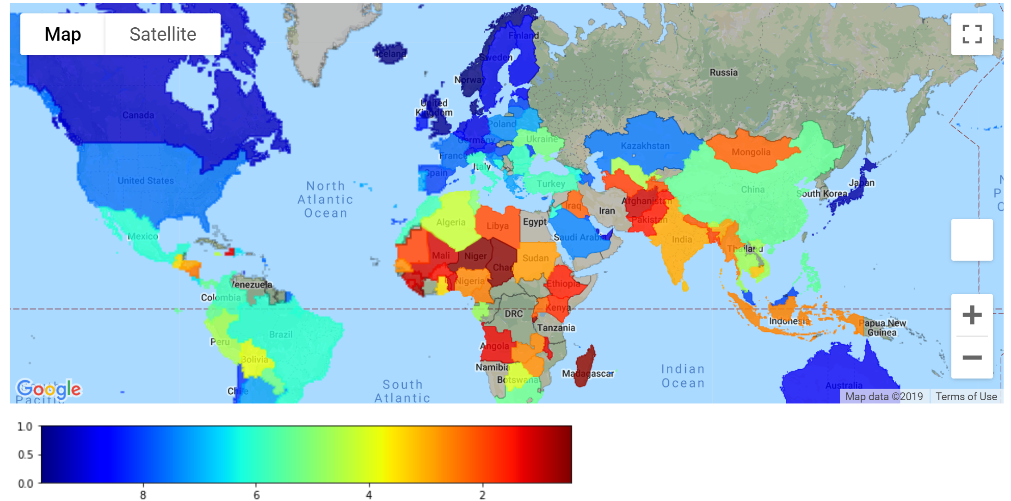
Internet access level throughout the world

Slide 21
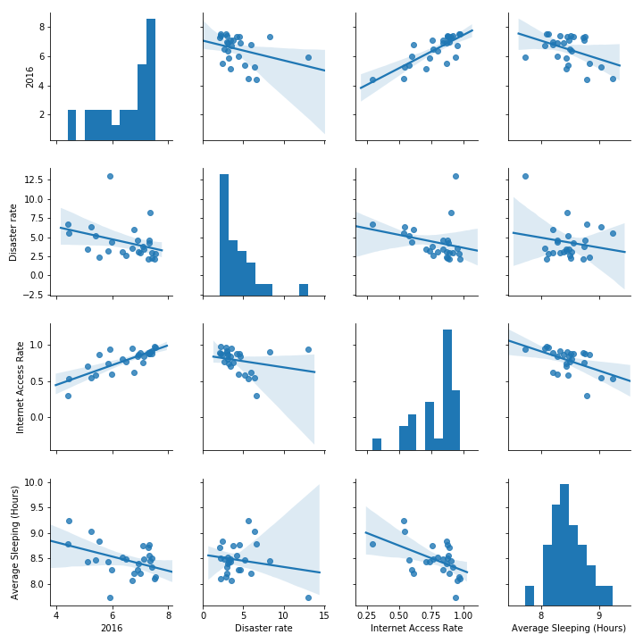
Variable Analysis Correlation between happiness score and disaster rate, internet access rate and sleeping.

Slide 22
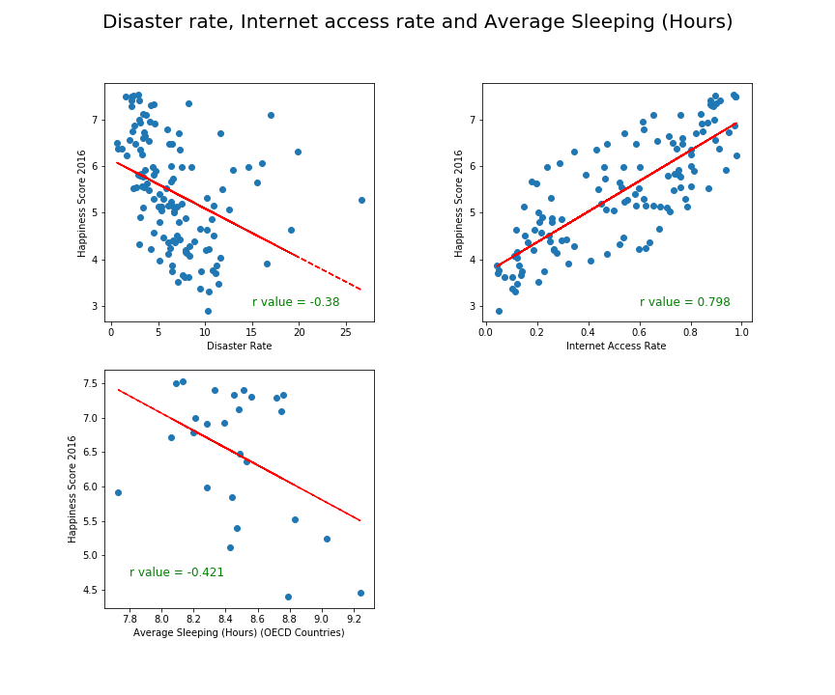
Variable Analysis Is there a relationship between Happiness and Disaster Risk, Internet access rate and Average Sleeping?

Slide 23
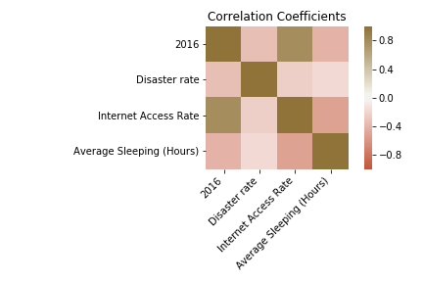
Variable Analysis Correlation Coefficients between happiness and disaster rate, internet access rate and average sleeping.

Slide 24
Discussion
We can conclude that higher Happiness Index around the world is concentrated in Europe, The Americas and Oceania, leaving Africa and Asia with the lower scores.
Finland, Norway, Denmark, Iceland and Switzerland are the countries with the higher Happiness Index score in the world. And they have consistently ranked at this level for 2015 to 2018.
Factors with high correlation to country happiness index:
GDP, Education Level, Access to Internet, ??????
Factors with some correlation to country happiness index:
Median age, Alcohol Consumption, Disaster Risk rate and Average Hours of Sleep
Factors with negative correlation to country happiness index:
?????????
Factors with no correlation to country happiness index:
????????, ????????

Slide 25
Followups
Further analysis
Knn
Seeing how variables relate to each other
Other measures of happiness
Happiness measure for major cities

Slide 26
Questions?

Slide 27

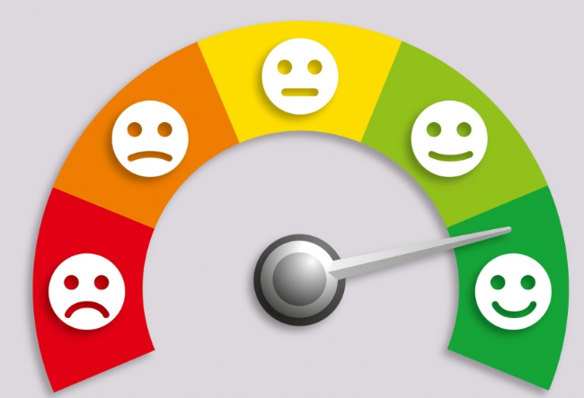

International Day of Happiness is on March 20th.

